Slide 1

Chapter 3: Scanning
陳奇業 成功大學資訊工程系

Slide 2
Scanner (or Lexical Analyzer)
the interface between source & compiler
could be a separate pass and places its output on an intermediate file.
more commonly, it is a routine called by parser.
scans character stream from where it left off and returns next token to parser. Actually the token's lexical category is returned in the form of a simple index number and a value for the token is left in the global variables. For some tokens only token type is returned.

Slide 3
Tokens
Tokens are logical entities that are usually defined as an enumberated type. For example, tokens might be defined in C as
typedef enum
{IF, THEN, ELSE, PLUS, MINUS, NUM, ID, ...}
TokenType;

Slide 4
Tokens
Although the task of the scanner is to convert the entire source program into a sequence of tokens, the scanner will rarely do this all at once.
Instead, the scanner will operate under the control of the parser, returning the single next token from the input on demand via a function that will have a declaration similar to the C declaration
TokenType getToken(void);

Slide 5
Input Buffering
Why input buffer is needed?
we can identify some token only when many characters beyond the token have been examined.
Two pointers (one marks the beginning of the token & the other one is a lookahead pointer) delimit the context of the token string.
However, the lookahead is limited.

Slide 6
a [index] = 4 + 2
a
[
i
n
d
e
x
]
=
4
+
2
Beginner
pointer
Lookahead
pointer
a
[
i
n
d
e
x
]
=
4
+
2
Beginner
pointer
Lookahead
pointer

Slide 7
Token, Pattern & Lexeme
A token is a sequence of characters that represents a unit of information in the source program.
In general, there is a set of strings in the input for which the same token is produced as output.
This set of strings is described by a rule called a pattern associated with the token. The pattern is said to match each specific string in the set.
A lexeme (詞素) is a sequence of characters in the source program that is matched by the pattern for a token.

Slide 8
Pattern vs. Regular Expression
Regular Expression: A notation suitable for describing tokens (patterns).
Each pattern is a regular language, i.e., it can be described by a regular expression

Slide 9
Two kinds of token
specific string ( e.g., "if" "," "=="), that is, a single string.
class of string (e.g., identifier, number, label), that is, a multiple strings.

Slide 10
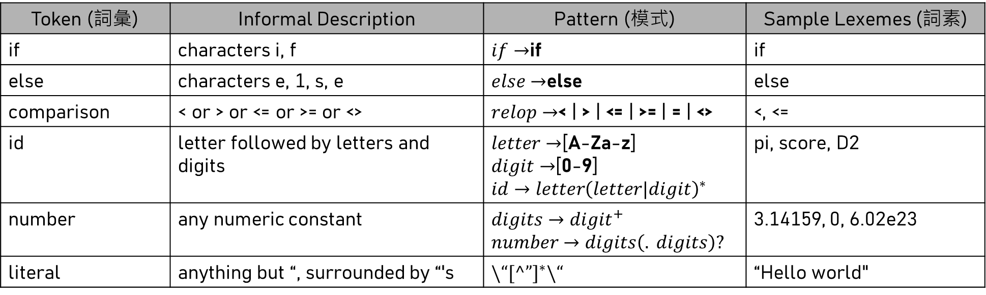
Examples of tokens
Token (詞彙) | Informal Description | Pattern (模式) | Sample Lexemes (詞素)
if | characters i, f | $if→$if | if
else | characters e, 1, s, e | $else→$else | else
comparison | < or > or <= or >= or <> | $relop→$< | > | <= | >= | = | <> | <, <=
id | letter followed by letters and digits | $letter→$[A-Za-z] $digit→$[0-9] $id→letter{\left(letter|digit\right)}^{∗}$ | pi, score, D2
number | any numeric constant | $digits→{digit}^{+}$ $number→digits\left(. digits\right)?$ | 3.14159, 0, 6.02e23
literal | anything but “, surrounded by “'s | $\backslash “{[^”]}^{∗}\backslash “$ | “Hello world"

Slide 11
Common Lexical Categories
identifiers
literals
keywords (not necessarily to be a reserved word) - What is the difference between keyword and reserved word?
operators
numbers
punctuation symbols: e.g. '(‘ , ';‘ , ','

Slide 12

The lexical categories are regular languages, and they can be described by giving regular expressions.

Slide 13

An instance: Scanning E = M * C ** 2
// return token type (an index) and value
==> < id, pointer to symbol table entry for E >
< assign_op >
< id, pointer to symbol table entry for M >
< mult_op >
< id, pointer to symbol table entry for C >
< expo_op >
< num, integer value 2 >

Slide 14

The compiler may store the character string that forms a number in a symbol table and let the attribute of token be a pointer to the table entry.

Slide 15
Regular Expression vs. Finite Automata
Regular Expression: A notation suitable for describing tokens (patterns).
Regular Expression can be converted into Finite Automata
Finite Automata: Formal specifications of transition diagrams

Slide 16
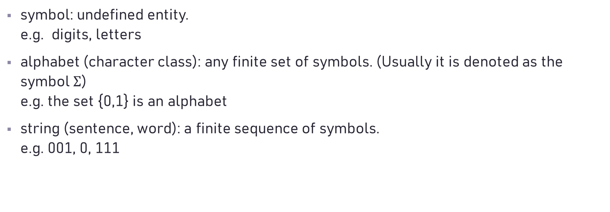
Definitions of String
symbol: undefined entity. e.g. digits, letters
alphabet (character class): any finite set of symbols. (Usually it is denoted as the symbol $Σ$) e.g. the set {0,1} is an alphabet
string (sentence, word): a finite sequence of symbols. e.g. 001, 0, 111

Slide 17
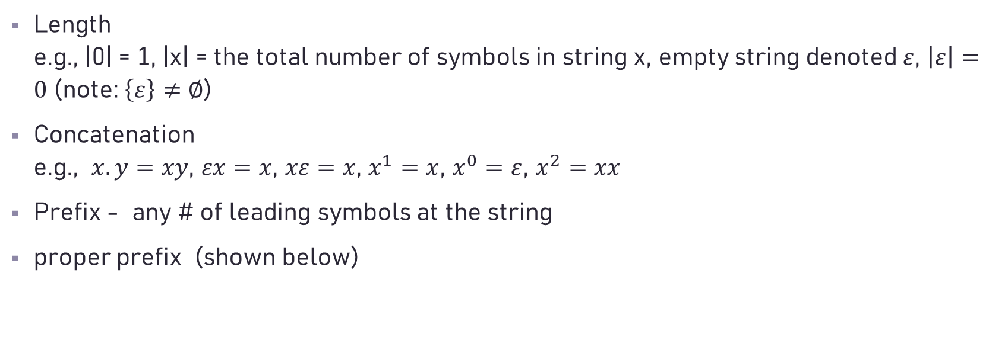
Operations of string (I)
Length e.g., |0| = 1, |x| = the total number of symbols in string x, empty string denoted $ε$, $\left|ε\right|=0$ (note: $\left\{ε\right\}≠∅$)
Concatenation e.g., $x.y=xy$, $εx=x$, $xε=x$, $x^{1}=x$, $x^{0}=ε$, $x^{2}=xx$
Prefix - any # of leading symbols at the string
proper prefix (shown below)

Slide 18
Operations of string (II)
Suffix - any # of trailing symbols at the string
proper suffix (explained below)
Substring - any string obtained by deleting a prefix and a suffix.
proper substring (explained below)

Slide 19
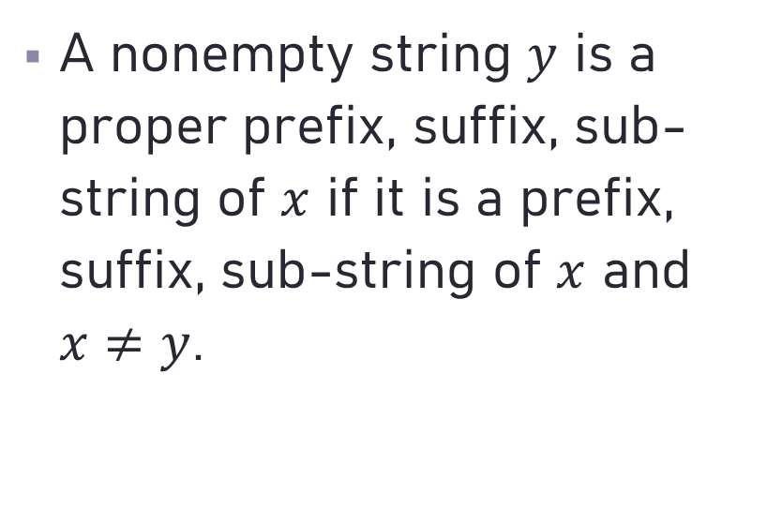
A nonempty string $y$ is a proper prefix, suffix, sub-string of $x$ if it is a prefix, suffix, sub-string of $x$ and $x≠y$.

Slide 20

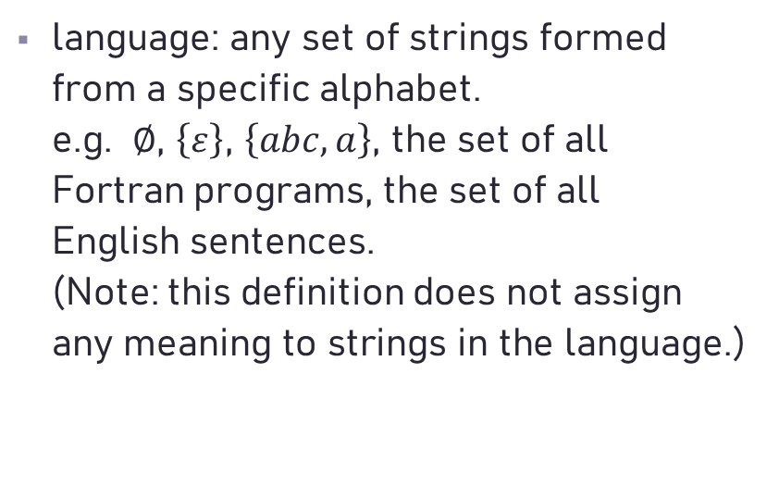
Definition of Language
language: any set of strings formed from a specific alphabet. e.g. $∅$, $\left\{ε\right\}$, $\left\{abc, a\right\}$, the set of all Fortran programs, the set of all English sentences. (Note: this definition does not assign any meaning to strings in the language.)

Slide 21
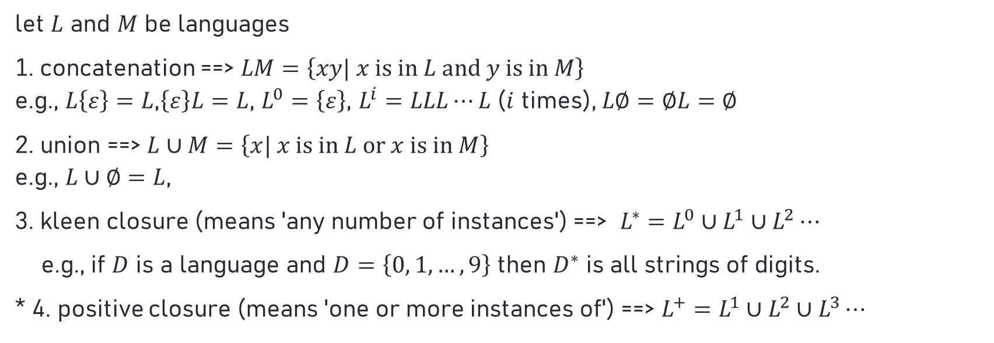
Three major operations for languages
let $L$ and $M$ be languages
1. concatenation ==> $LM=\left\{xy| x \text{is} \text{in} L \text{and} y \text{is} \text{in} M\right\}$ e.g., $L\left\{ε\right\}=L$,$\left\{ε\right\}L=L$, $L^{0}=\left\{ε\right\}$, $L^{i}=LLL⋯L$ ($i$ times), $L∅=∅L=∅$
2. union ==> $L∪M=\left\{x| x \text{is} \text{in} L \text{or} x \text{is} \text{in} M\right\}$ e.g., $L∪∅=L$,
3. kleen closure (means 'any number of instances') ==> $L^{∗}=L^{0}∪L^{1}∪L^{2}⋯$
e.g., if $D$ is a language and $D=\left\{0, 1, …, 9\right\}$ then $D^{∗}$ is all strings of digits.
* 4. positive closure (means 'one or more instances of') ==> $L^{+}=L^{1}∪L^{2}∪L^{3}⋯$

Slide 22
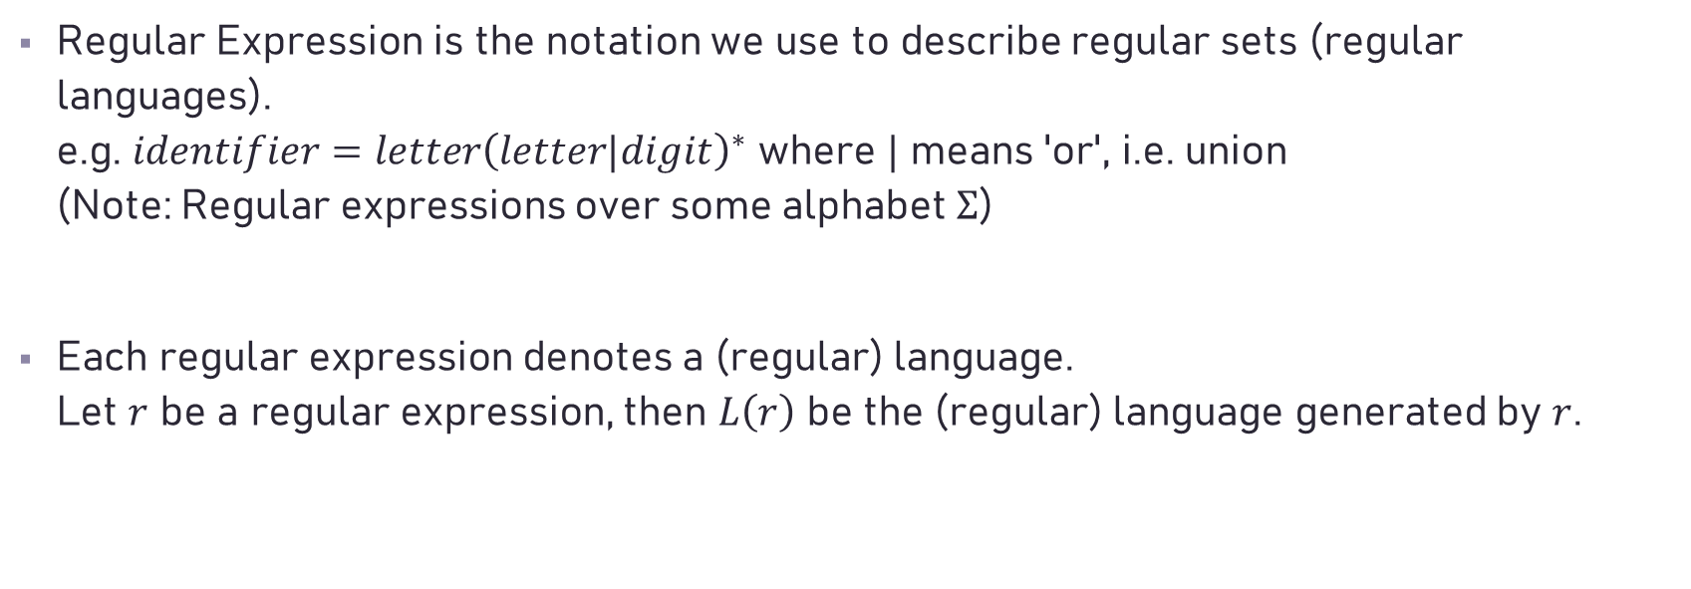
Regular Expression vs. Regular Language
Regular Expression is the notation we use to describe regular sets (regular languages). e.g. $identifier=letter{\left(letter|digit\right)}^{∗}$ where $|$ means 'or', i.e. union (Note: Regular expressions over some alphabet $Σ$)
Each regular expression denotes a (regular) language. Let $r$ be a regular expression, then $L\left(r\right)$ be the (regular) language generated by $r$.

Slide 23

$$letter = a|b|..|z|A|B|..|Z$$
$$digit = 0|1|2|..|9$$
$$identifier=letter{\left(letter|digit\right)}^{∗}$$

Slide 24
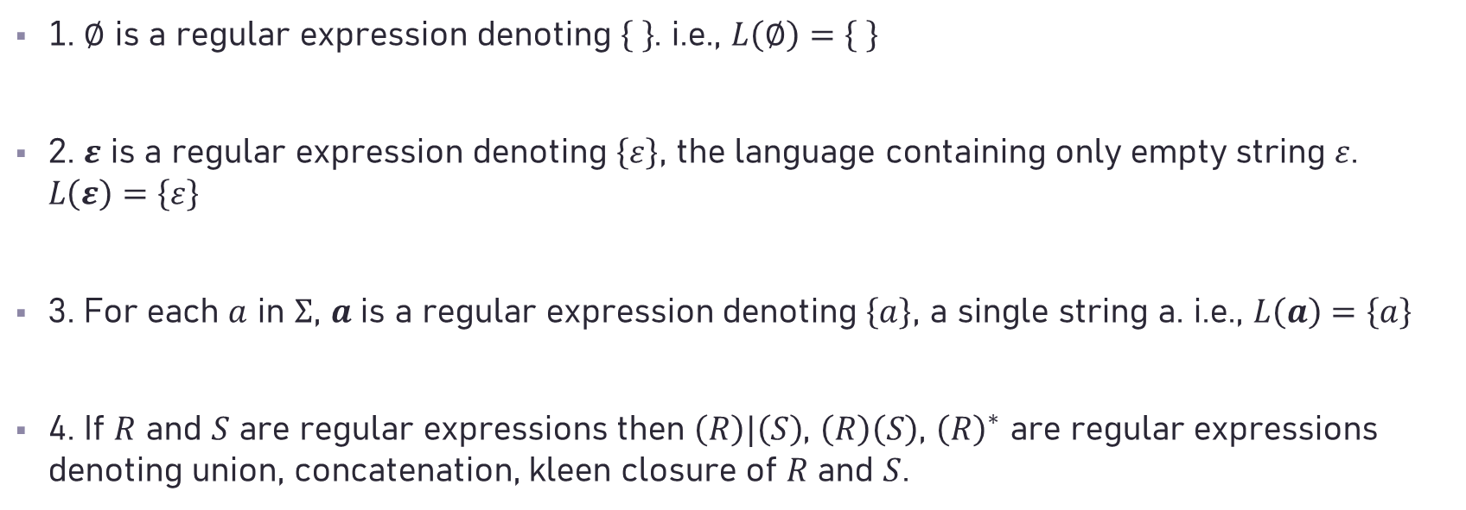
Rules for constructing regular expressions
1. $∅$ is a regular expression denoting . i.e., $L\left(∅\right)=\left\{ \right\}$
2. $ε$ is a regular expression denoting $\left\{ε\right\}$, the language containing only empty string $ε$. $L\left(ε\right)=\left\{ε\right\}$
3. For each $a$ in $Σ$, $a$ is a regular expression denoting $\left\{a\right\}$, a single string a. i.e., $L\left(a\right)=\left\{a\right\}$
4. If $R$ and $S$ are regular expressions then $\left(R\right)|\left(S\right)$, $\left(R\right)\left(S\right)$, ${\left(R\right)}^{∗}$ are regular expressions denoting union, concatenation, kleen closure of $R$ and $S$.

Slide 25

Rules of Regular Expressions
$R|S=S|R$
$R|(S|T)=(R|S)|T$
$R(S|T)=RS|RT, (S|T)R = SR|TR$
$R(ST)=(RS)T$
$εR=Rε=R$
* Precedence: $\left( \right), ∗, ∙ , |$

Slide 26
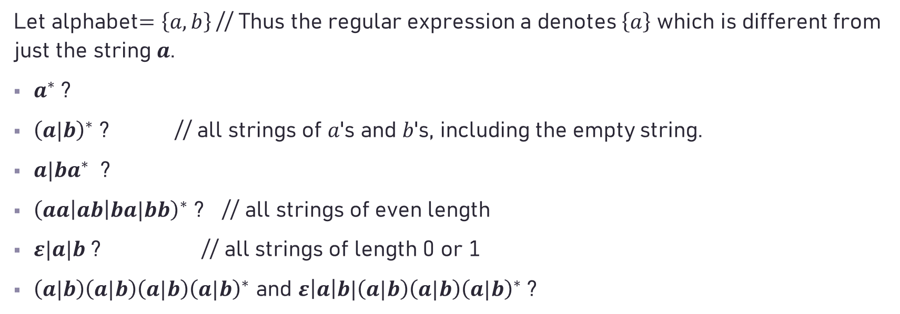
What do the following regular expressions mean?
Let alphabet$=\left\{a, b\right\}$ // Thus the regular expression a denotes $\left\{a\right\}$ which is different from just the string $a$.
$a^{∗}$ ?
${\left(a|b\right)}^{∗}$ ? // all strings of $a$'s and $b$'s, including the empty string.
$a|ba^{∗}$ ?
${\left(aa\left|ab\right|ba|bb\right)}^{∗}$ ? // all strings of even length
$ε|a|b$ ? // all strings of length 0 or 1
$\left(a|b\right)\left(a|b\right)\left(a|b\right){\left(a|b\right)}^{∗}$ and $ε\left|a\right|b|\left(a|b\right)\left(a|b\right){\left(a|b\right)}^{∗}$ ?

Slide 27

Question: Show how to denote all strings of length not 2.
Question: Show how to denote the comments of C language.

Slide 28

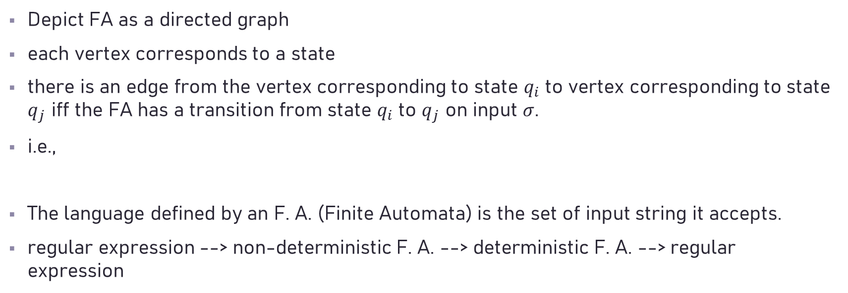


Finite Automata (Finite state machine)
Depict FA as a directed graph
each vertex corresponds to a state
there is an edge from the vertex corresponding to state $q_{i}$ to vertex corresponding to state $q_{j}$ iff the FA has a transition from state $q_{i}$ to $q_{j}$ on input $σ$.
i.e.,
The language defined by an F. A. (Finite Automata) is the set of input string it accepts.
regular expression --> non-deterministic F. A. --> deterministic F. A. --> regular expression
$$σ$$
$$q_{i}$$
$$q_{j}$$

Slide 29
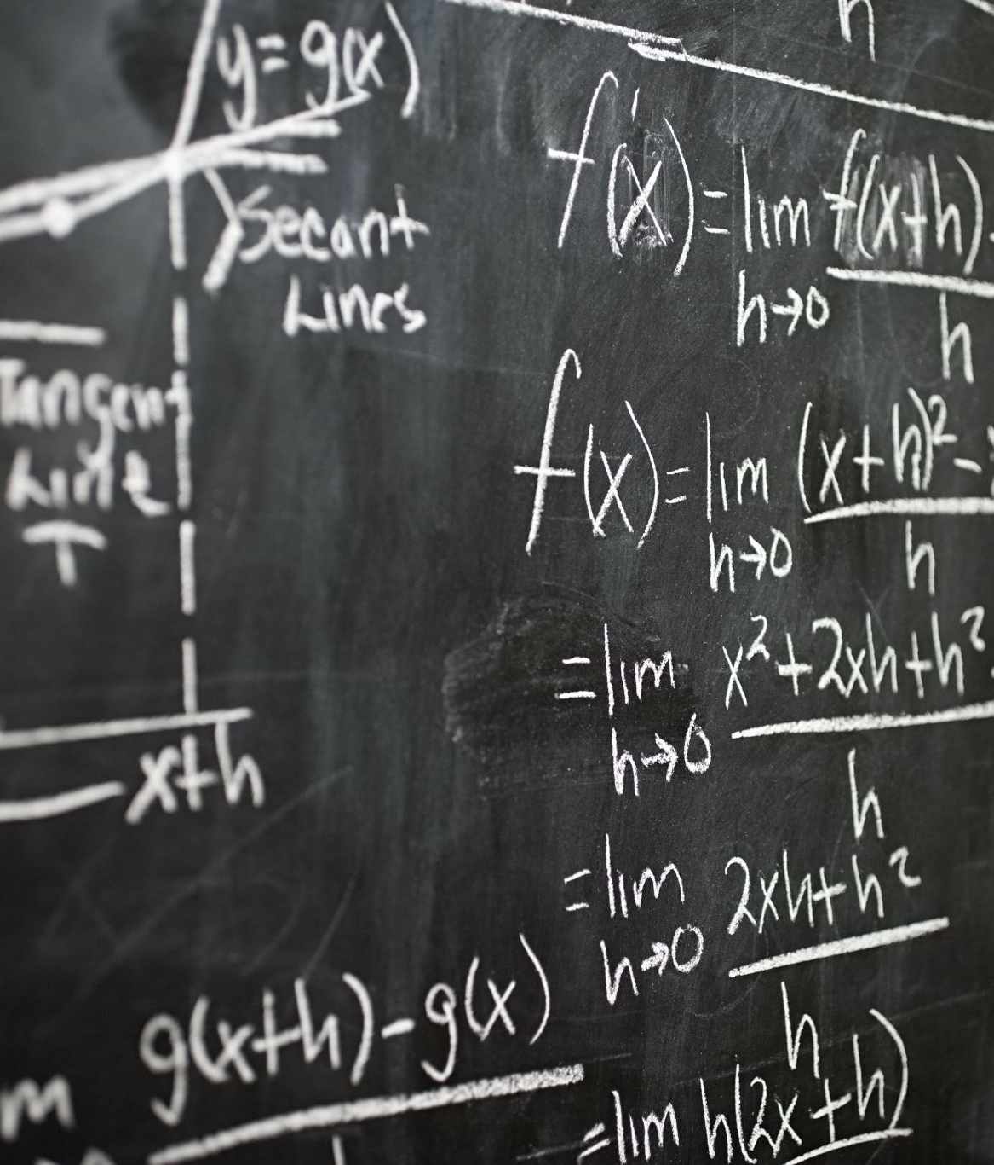

Deterministic Finite Automata
It has no transition on input $ε$
For each state s and input symbol a, there is at most one edge labeled a leaving $s$.
$M=\left(Q, Σ, δ, q_{0}, F\right)$, where $Q$ = a finite set of states $Σ$ = a set of finite characters $δ$= transition function $δ:Q×Σ→Q$ $q_{0}$ = starting state $F$ = a set of accepting states (a subset of $Q$ i.e. $F⊆Q$)

Slide 30













e.g. DFA accepting (a|b)*abb
$Q=\left\{q_{0},q_{1},q_{2},q_{3}\right\}$
$Σ=\left\{a, b\right\}$
$q_{0}=$starting state
$F=\left\{q_{3}\right\}$
$δ\left(q_{0}, a\right)=q_{1} δ\left(q_{0}, b\right)=q_{0} δ\left(q_{1}, a\right)=q_{1}$
$δ\left(q_{1}, b\right)=q_{2} δ\left(q_{2}, a\right)=q_{1} δ\left(q_{2}, b\right)=q_{3}$
$δ\left(q_{3}, a\right)=q_{1} δ\left(q_{3}, b\right)=q_{0}$
$$b$$
$$a$$
$$a$$
$$q_{0}$$
$$a$$
$$q_{1}$$
$$b$$
$$q_{2}$$
$$b$$
$$q_{3}$$
$$a$$
$$b$$

Slide 31
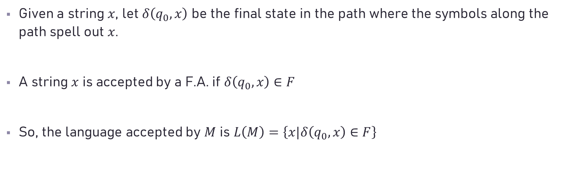
Given a string $x$, let $δ\left(q_{0}, x\right)$ be the final state in the path where the symbols along the path spell out $x$.
A string $x$ is accepted by a F.A. if $δ\left(q_{0}, x\right)∈F$
So, the language accepted by $M$ is $L\left(M\right)=\left\{x|δ\left(q_{0}, x\right)∈F\right\}$

Slide 32










$$:$$
$$=$$
reture ASSIGN
$$<$$
$$=$$
reture LE
$$=$$
reture EQ
$$=$$
reture ASSIGN
$$:$$
$$<$$
$$=$$
reture LE
$$=$$
reture EQ

Slide 33






$$<$$
$$=$$
reture LE
$$<$$
$$>$$
reture NE
$$<$$
reture LT
$$=$$
$$<$$
$$<$$
$$>$$
It is not a DFA!!
$$<$$

Slide 34




$$=$$
$$<$$
$$>$$
complexity
$$[other]$$
if we want to combine multiple DFA

Slide 35
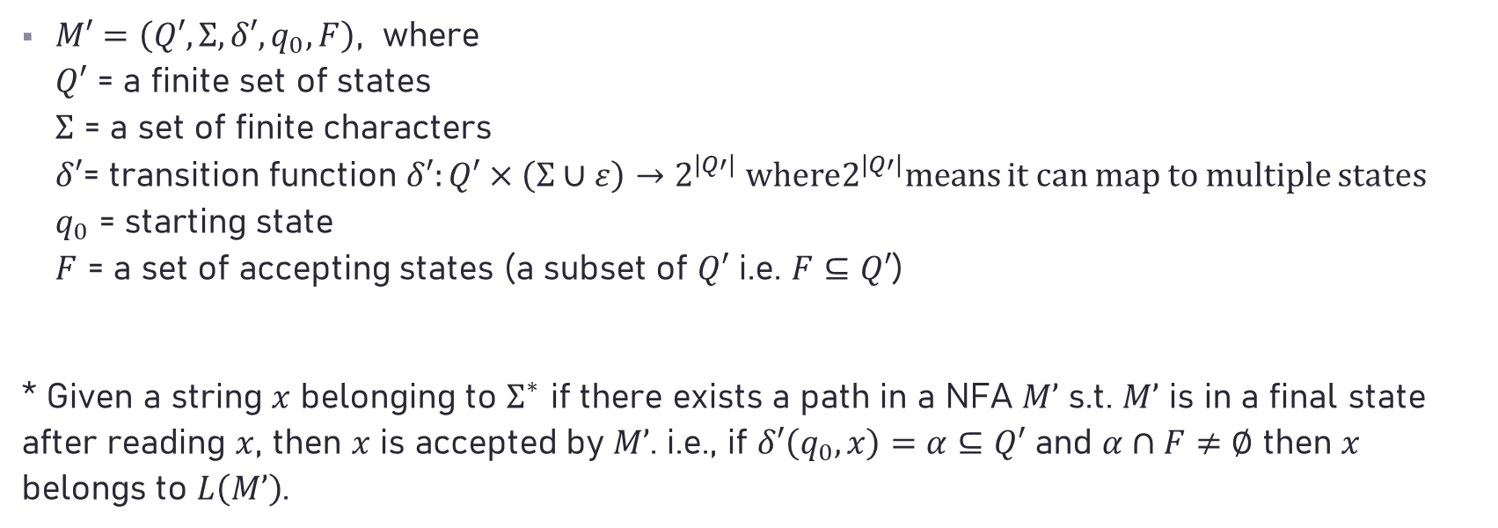
Non-deterministic Finite Automata
$M′=\left(Q′, Σ, δ′, q_{0}, F\right)$, where $Q′$ = a finite set of states $Σ$ = a set of finite characters $δ′$= transition function $δ′:Q′×\left(Σ∪ε\right)→2^{\left|Q′\right|}$ where$2^{\left|Q′\right|}$means it can map to multiple states $q_{0}$ = starting state $F$ = a set of accepting states (a subset of $Q′$ i.e. $F⊆Q′$)
* Given a string $x$ belonging to $Σ^{∗}$ if there exists a path in a NFA $M’$ s.t. $M’$ is in a final state after reading $x$, then $x$ is accepted by $M’$. i.e., if $δ′\left(q_{0}, x\right)=α⊆Q′$ and $α∩F≠∅$ then $x$ belongs to $L\left(M’\right)$.

Slide 36


e.g. NFA accepting (a|b)*abb
$Q^{′}=\left\{q_{0},q_{1},q_{2},q_{3}\right\}$, $Σ=\left\{a, b\right\}$, $q_{0}=$ starting state
$F=\left\{q_{3}\right\}$
$δ\left(q_{0}, a\right)=\left\{q_{0},q_{1}\right\}, δ\left(q_{0}, b\right)=\left\{q_{0}\right\}, δ\left(q_{1}, b\right)=\left\{q_{2}\right\}$
$δ\left(q_{2}, b\right)=\left\{q_{3}\right\}$
$$a, b$$
$$q_{0}$$
$$a$$
$$q_{1}$$
$$b$$
$$q_{2}$$
$$b$$
$$q_{3}$$

Slide 37
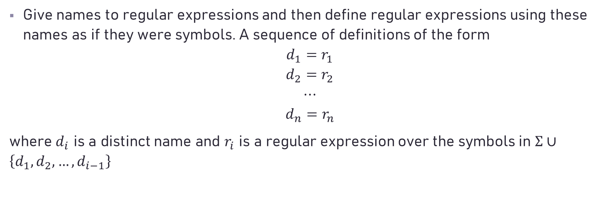
Regular Definition
Give names to regular expressions and then define regular expressions using these names as if they were symbols. A sequence of definitions of the form
$$d_{1}=r_{1}$$
$$d_{2}=r_{2}$$
$$⋯$$
$$d_{n}=r_{n}$$
where $d_{i}$ is a distinct name and $r_{i}$ is a regular expression over the symbols in $Σ∪\left\{d_{1},d_{2}, …,d_{i−1}\right\}$

Slide 38

An Example
$$letter = a|b|..|z|A|B|..|Z$$
$$digit = 0|1|2|..|9$$
$$identifier=letter{\left(letter|digit\right)}^{∗}$$

Slide 39
Lexical Analyzer: May return token's lexical category (an index) and value (in global variable) or token's lexical category only
e.g.
letter(letter|digit)* {yylval = install(); return ID;}
digit+ {yylval = install(); return NUM;}
"<" {yylval = LT; return RELOP;}

Slide 40
Trick for differentiating keyword and identifier
install all keywords in symbol table first

Slide 41
Theorem
The followings are equivalent:
regular expression
NFA
DFA
regular language
regular grammar

Slide 42



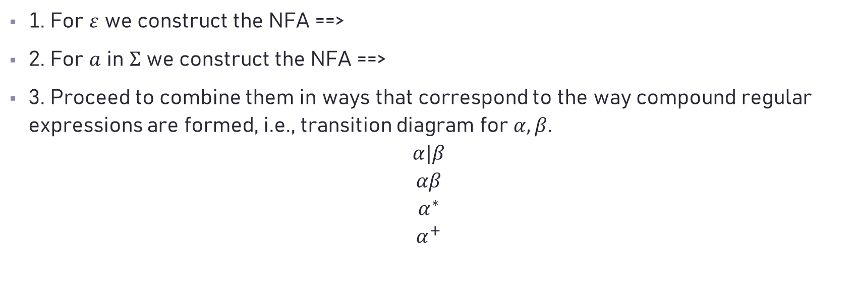



Algorithm: Constructing an NFA from a regular expression
$$ε$$
$$q_{0}$$
$$q_{1}$$
1. For $ε$ we construct the NFA ==>
2. For $a$ in $Σ$ we construct the NFA ==>
3. Proceed to combine them in ways that correspond to the way compound regular expressions are formed, i.e., transition diagram for $α, β$.
$$α|β$$
$$αβ$$
$$α^{∗}$$
$$α^{+}$$
$$a$$
$$q_{0}$$
$$q_{1}$$

Slide 43






















$$α$$
$$ε$$
$$ε$$
$$α|β$$
$$q_{0}$$
$$q_{1}$$
$$ε$$
$$ε$$
$$β$$
$$αβ$$
$$q_{0}$$
$$α$$
$$β$$
$$q_{1}$$
$$ε$$
$$α^{∗}$$
$$ε$$
$$ε$$
$$q_{0}$$
$$α$$
$$q_{1}$$
$$ε$$

Slide 44















Example:
Construct the r.e. ${(a|b)}^{∗}abb$ based on the above algorithm.
$$a$$
$$b$$
$$a$$
2
$$3$$
$$b$$
4
$$5$$
$$a$$
3
2
$$ε$$
$$ε$$
$$a|b$$
1
$$6$$
$$ε$$
$$b$$
5
$$ε$$
4

Slide 45




































$$ε$$
$$a$$
$$a$$
7
$$8$$
$$b$$
$$a$$
$$b$$
8
$$9$$
2
3
$$ε$$
$$ε$$
$${\left(a|b\right)}^{∗}$$
$$ε$$
$$ε$$
0
1
6
$$7$$
$$ε$$
$$b$$
5
$$ε$$
4
$$b$$
$$b$$
9
$$10$$
$$ε$$
$$ε$$
$$a$$
3
2
$$ε$$
$$ε$$
$$ε$$
$$ε$$
$$a$$
$$b$$
$$b$$
$${\left(a|b\right)}^{∗}abb$$
0
1
6
7
8
9
$$10$$
$$ε$$
$$b$$
5
$$ε$$
4
$$ε$$

Slide 46


How to construct a DFA based on an equivalent NFA?
Each state of the DFA is a set of states which the NFA could be in after reading some sequence of input symbols.
The initial state of the DFA is the set consisting of 0, the initial state of NFA, together with all states of NFA that can be reached from 0 by means of $ε$-transition.

Slide 47
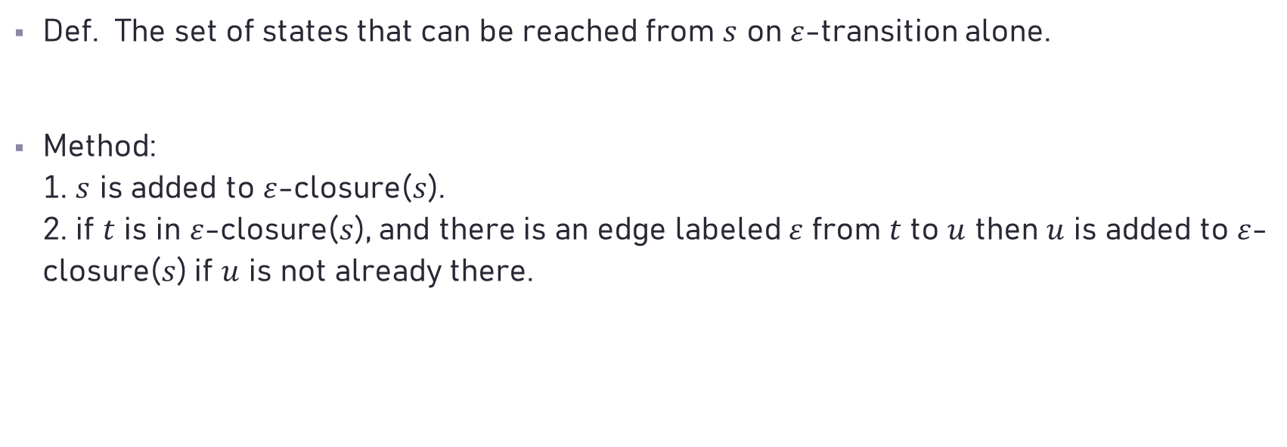

$ε$-closure($s$)
Def. The set of states that can be reached from $s$ on $ε$-transition alone.
Method: 1. $s$ is added to $ε$-closure($s$). 2. if $t$ is in $ε$-closure($s$), and there is an edge labeled $ε$ from $t$ to $u$ then $u$ is added to $ε$-closure($s$) if $u$ is not already there.

Slide 48
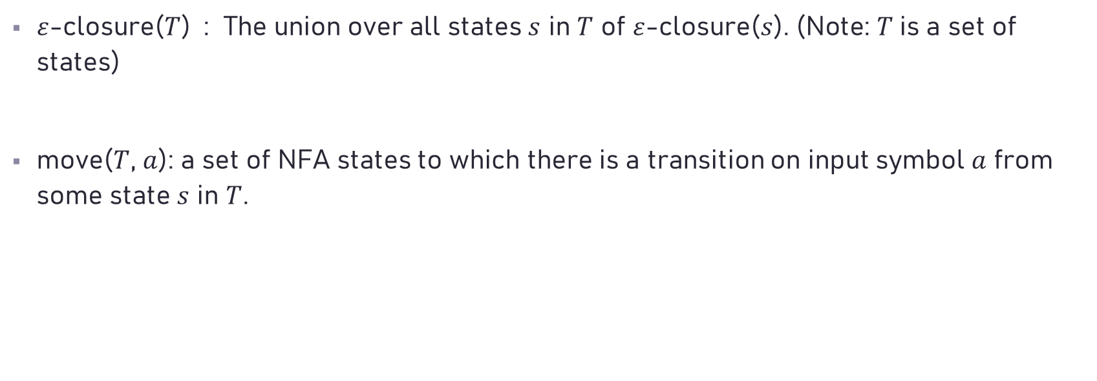
$ε$-closure($T$) : The union over all states $s$ in $T$ of $ε$-closure($s$). (Note: $T$ is a set of states)
move($T$, $a$): a set of NFA states to which there is a transition on input symbol $a$ from some state $s$ in $T$.

Slide 49
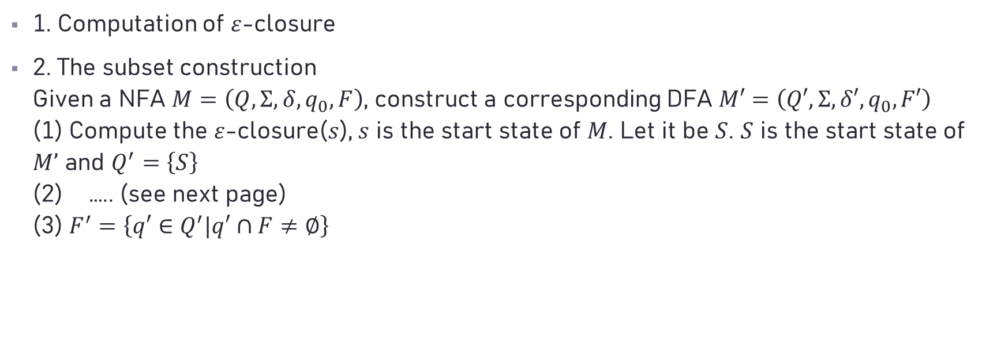
Algorithms
1. Computation of $ε$-closure
2. The subset construction Given a NFA $M=\left(Q, Σ, δ, q_{0}, F\right)$, construct a corresponding DFA $M′=\left(Q′, Σ, δ′, q_{0}, F′\right)$ (1) Compute the $ε$-closure($s$), $s$ is the start state of $M$. Let it be $S$. $S$ is the start state of $M’$ and $Q^{′}=\left\{S\right\}$ (2) ….. (see next page) (3) $F^{′}=\left\{q′∈Q^{′}|q′∩F≠∅\right\}$

Slide 50

initially, $ε$-closure($s$) is the only state in $Q^{′}$, and it is unmarked;
while ( there is an unmarked state $T$ in $Q^{′}$) {
mark $T$;
for ( each input symbol $a∈Σ$) {
$U=ε$-closure(move($T, a$));
if ($U$ is not in $Q^{′}$)
add $U$ as an unmarked state to $Q^{′}$;
$δ^{′}\left(T, a\right)=U$;
}
}
$F^{′}=\left\{q′∈Q^{′}|q′∩F≠∅\right\}$;

Slide 51
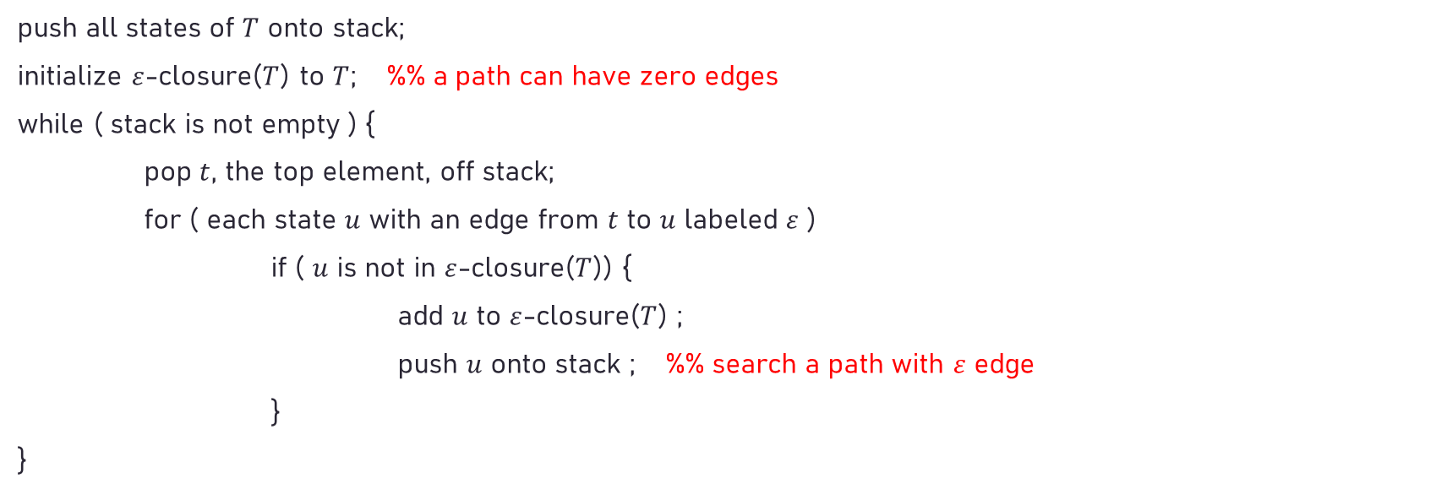

Computing $ε$-closure($T$)
push all states of $T$ onto stack;
initialize $ε$-closure($T$) to $T$; %% a path can have zero edges
while ( stack is not empty ) {
pop $t$, the top element, off stack;
for ( each state $u$ with an edge from $t$ to $u$ labeled $ε$ )
if ( $u$ is not in $ε$-closure($T$)) {
add $u$ to $ε$-closure($T$) ;
push $u$ onto stack ; %% search a path with $ε$ edge
}
}

Slide 52
















Example: ${(a|b)}^{∗}abb$
The start state $A$ of the equivalent DFA is $ε$-closure($0$), or $A=\left\{0, 1, 2, 4, 7\right\}$
$$ε$$
$$a$$
3
2
$$ε$$
$$ε$$
$$ε$$
$$ε$$
$$a$$
$$b$$
$$b$$
0
1
6
7
8
9
$$10$$
$$ε$$
$$b$$
5
$$ε$$
4
$$ε$$

Slide 53















$A=\left\{0, 1, 2, 4, 7\right\}$
move($A, a$)$=\left\{3, 8\right\}$, move($A, b$)$=\left\{5\right\}$
$B=ε$-closure($\text{move}\text{(}A, a\text{)}$)$=\left\{1, 2, 3, 4, 6, 7, 8\right\}$, $δ^{′}\left(A, a\right)=B$ $C=ε$-closure($\text{move}\text{(}A, b\text{)}$)$=\left\{1, 2, 4, 5, 6, 7\right\}$, $δ^{′}\left(A, b\right)=C$
move($B, a$)$=\left\{3, 8\right\}$, move($B, b$)$=\left\{5, 9\right\}$
$δ^{′}\left(B, a\right)=B$ $D=ε$-closure($\text{move}\text{(}B, b\text{)}$)$=\left\{1, 2, 4, 5, 6, 7, 9\right\}$, $δ^{′}\left(B, b\right)=D$
$$ε$$
$$a$$
3
2
$$ε$$
$$ε$$
$$ε$$
$$ε$$
$$a$$
$$b$$
$$b$$
0
1
6
7
8
9
$$10$$
$$ε$$
$$b$$
5
$$ε$$
4
$$ε$$

Slide 54















$C=\left\{1, 2, 4, 5, 6, 7\right\}$
move($C, a$)$=\left\{3, 8\right\}$, move($C, b$)$=\left\{5\right\}$
$ε$-closure($\text{move}\text{(}C, a\text{)}$)$=B$, $δ^{′}\left(C, a\right)=B$ $ε$-closure($\text{move}\text{(}C, b\text{)}$)$=C$, $δ^{′}\left(C, b\right)=C$
$D=\left\{1, 2, 4, 5, 6, 7, 9\right\}$
move($D, a$)$=\left\{3, 8\right\}$, move($D, b$)$=\left\{5, 10\right\}$
$ε$-closure($\text{move}\text{(}D, a\text{)}$)$=B$, $δ^{′}\left(D, a\right)=B$ $E=ε$-closure($\text{move}\text{(}D, b\text{)}$)$=\left\{1, 2, 4, 5, 6, 7, 10\right\}$, $δ^{′}\left(C, b\right)=E$
$$ε$$
$$a$$
3
2
$$ε$$
$$ε$$
$$ε$$
$$ε$$
$$a$$
$$b$$
$$b$$
0
1
6
7
8
9
$$10$$
$$ε$$
$$b$$
5
$$ε$$
4
$$ε$$

Slide 55















$E=\left\{1, 2, 4, 5, 6, 7, 10\right\}$
move($E, a$)$=\left\{3, 8\right\}$, move($E, b$)$=\left\{5\right\}$
$ε$-closure($\text{move}\text{(}E, a\text{)}$)$=B$, $δ^{′}\left(E, a\right)=B$ $ε$-closure($\text{move}\text{(}E, b\text{)}$)$=C$, $δ^{′}\left(E, b\right)=C$
$$ε$$
$$a$$
3
2
$$ε$$
$$ε$$
$$ε$$
$$ε$$
$$a$$
$$b$$
$$b$$
0
1
6
7
8
9
$$10$$
$$ε$$
$$b$$
5
$$ε$$
4
$$ε$$

Slide 56






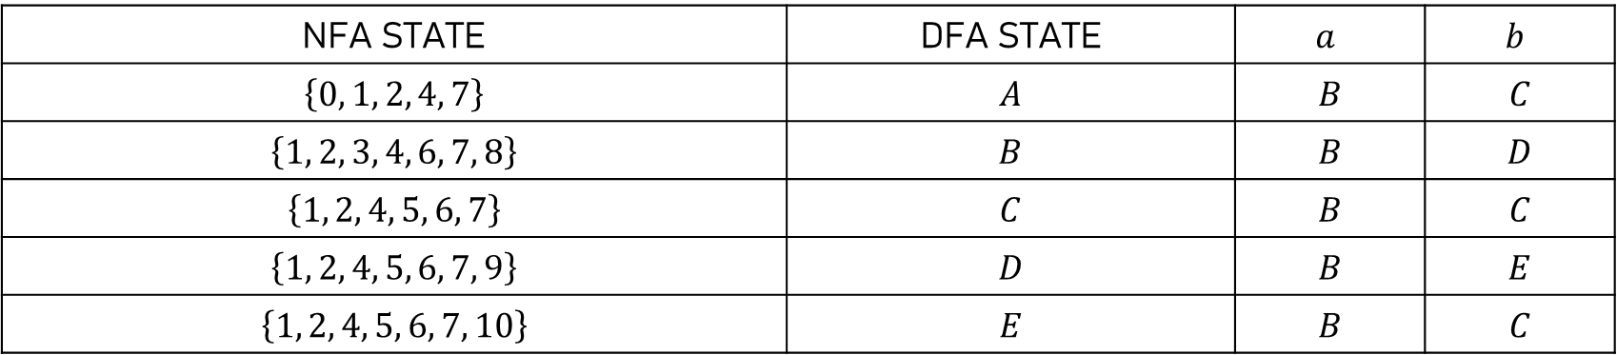









NFA STATE | DFA STATE | $$a$$ | $$b$$
$$\left\{0, 1, 2, 4, 7\right\}$$ | $$A$$ | $$B$$ | $$C$$
$$\left\{1, 2, 3, 4, 6, 7, 8\right\}$$ | $$B$$ | $$B$$ | $$D$$
$$\left\{1, 2, 4, 5, 6, 7\right\}$$ | $$C$$ | $$B$$ | $$C$$
$$\left\{1, 2, 4, 5, 6, 7, 9\right\}$$ | $$D$$ | $$B$$ | $$E$$
$$\left\{1, 2, 4, 5, 6, 7, 10\right\}$$ | $$E$$ | $$B$$ | $$C$$
$$b$$
$$C$$
$$b$$
$$b$$
$$a$$
$$A$$
$$a$$
$$B$$
$$b$$
$$D$$
$$b$$
$$E$$
$$a$$
$$a$$
$$a$$

Slide 57
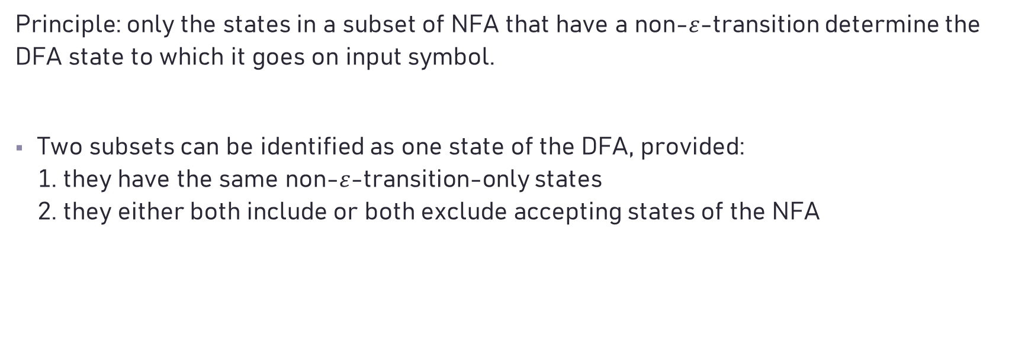
Minimizing the number of states of DFA
Principle: only the states in a subset of NFA that have a non-$ε$-transition determine the DFA state to which it goes on input symbol.
Two subsets can be identified as one state of the DFA, provided: 1. they have the same non-$ε$-transition-only states 2. they either both include or both exclude accepting states of the NFA

Slide 58
Algorithm:
If there are two accepting states s and t that have transitions on a that land in different sets, then no a-transition can be defined for this grouping of the states. We say that a distinguishes the states s and t.
Two states are distinguished if there exists a string which leads to final states and non-final states when it is fed to the two states.
Find all groups of states that can be distinguished by some input string.
1. Construct a partition and repeat the algorithm of getting a new partition.
2. Pick a representative for each group.
3. Delete a dead state and states unreachable from the initial state. Make the transition to the dead states undefined.
Notes:
如果存在一個字串從這二個states開始, 使得一個達到接受狀態, 另一個達到非接受狀態, 則我們稱這二個state distinguished

Slide 59

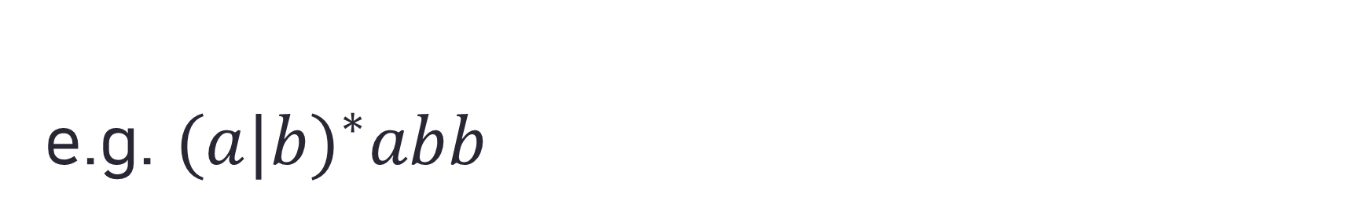
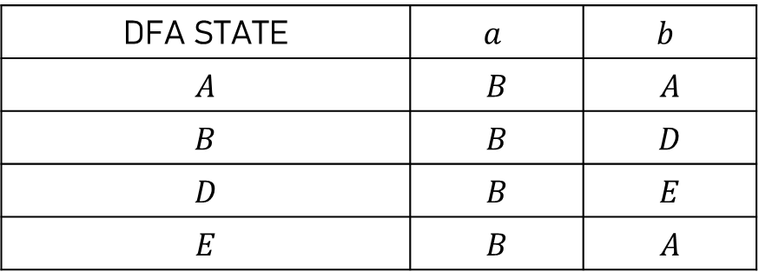
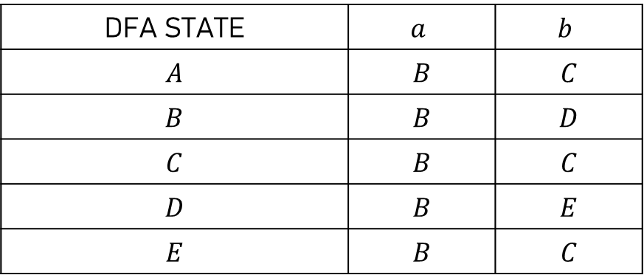
e.g. ${(a|b)}^{∗}abb$
DFA STATE | $$a$$ | $$b$$
$$A$$ | $$B$$ | $$C$$
$$B$$ | $$B$$ | $$D$$
$$C$$ | $$B$$ | $$C$$
$$D$$ | $$B$$ | $$E$$
$$E$$ | $$B$$ | $$C$$
1. $\left(A B C D\right)\left(E\right)$← accepting state
2. $\left(A B C\right)\left(D\right)\left(E\right)$
3. $\left(A C\right)\left(B\right)\left(D\right)\left(E\right)$
DFA STATE | $$a$$ | $$b$$
$$A$$ | $$B$$ | $$A$$
$$B$$ | $$B$$ | $$D$$
$$D$$ | $$B$$ | $$E$$
$$E$$ | $$B$$ | $$A$$

Slide 60
Steps for developing a lexical analyzer:
For each of these regular expression we construct an NFA with a single start and single accepting state.
Piece these together into a single NFA a. add a start state and epsilon-transitions from it to the start state of the individual NFA b. index the accepting state with the lexical category that they accept.

Slide 61
Convert the NFA to produce a corresponding DFA a. A DFA state accepts for a given lexical category iff it contains a NFA accepting state for that category. b. If more than one such category we allow only the one of highest precedence. c. either the state or the previous states containing one or more final states of the NFA.
Minimize the number of states of the DFA

Slide 62











An Example:
Build a lexical analyzer for 3 tokens denoted as: $a$ // regular expression $abb$ // regular expression $a^{∗}b^{+}$ // regular expression
STEP 1: Construct NFA for each regular expression
$$a$$
1
$$2$$
3
$$a$$
4
$$b$$
5
$$b$$
$$6$$
$$a$$
$$b$$
7
$$b$$
$$8$$

Slide 63






















STEP 2: NFA recognizing three different tokens
$$a$$
1
$$2$$
$$ε$$
$$ε$$
3
$$a$$
4
$$b$$
5
$$b$$
0
$$6$$
$$ε$$
$$a$$
$$b$$
7
$$b$$
$$8$$
STEP 3: NFA to DFA
$$a$$
2 4 7
7
$$a$$
$$a$$
0 1 3 7
$$b$$
$$b$$
6 8
8
$$b$$
5 8
$$b$$
$$b$$
$$b$$

Slide 64














STEP 4: Minimizing the number of states of DFA (No change)
Suppose the input character stream is: $aba→a^{∗}b^{+}$ (token recognized $ab$)
Suppose the input character stream is: $abb→abb$ (token recognized)
$$a$$
$$a$$
2 4 7
7
$$a$$
$$a$$
0 1 3 7
$$b$$
$$b$$
6 8
8
$$b$$
5 8
$$abb$$
$$b$$
$$b$$
$$b$$
$$a^{∗}b^{+}$$
$$a^{∗}b^{+}$$

Slide 65
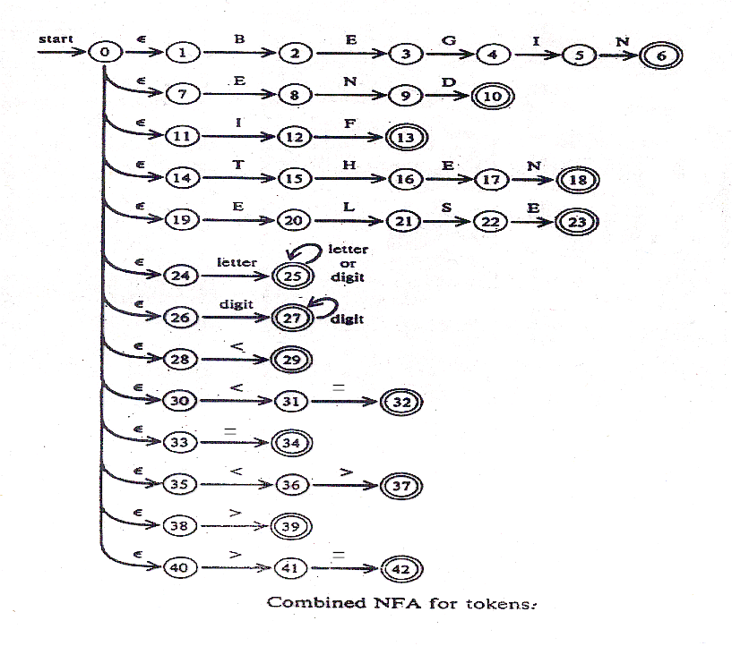

Slide 66
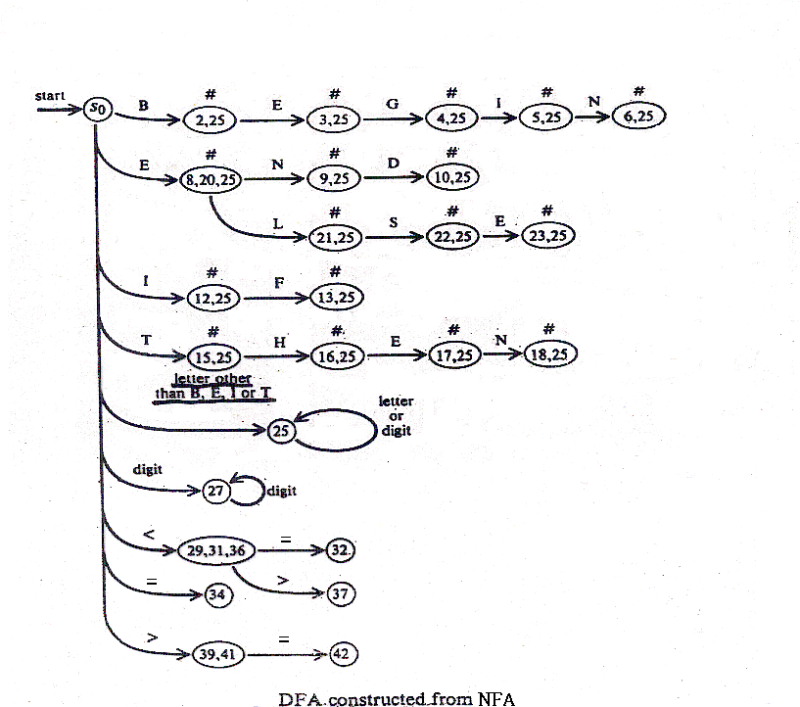
Note: The states marked ‘#’
have transitions to state {25}
on all letters and digits.

Slide 67
Problems:
Y = X + 1 CFG1: id = function + id CFG2: id = id + id Ans: Make things as easy as possible for the parser. It should be left to scanner to determine if X is a variable or a function.
When to quit? X <> Y Ans: Go for longest possible fit

Slide 68
Problems:
What if there is a tie for the tokens? e.g., an input which matches patterns for identifier and a keyword Ans: Given a precedence to the lexical category. (Usually first mentioned has highest priority)
What if you don't know until after the end of the longest pattern? Ans: Put a slash at the point where the scanning resumes if it is the desired token, other than the end of the pattern. e.g. in Fortran DO 99 I = 1, 100 → DO99I=1,100 DO 99 I = 1.100 → DO99I=1.100 So, do/({letter}|{digit})* = ({letter}|{digit})*, for pattern "do"

Slide 69
e.g. if/\(.*\){letter} for pattern "if“ (if(i,j) = 3 is legal in Fortran)
That is, we mark the restart position in the regular expression by a slash.
for (i=1; i<=100; i++)
{
x = …
y = …
……..
……..
}
DO 99 I = 1, 100
X = …
Y = …
……..
…….
99 Continue

Slide 70




When converting the NFA to DFA for such regular expression we create a special state for each “/” transition.
e.g. becomes ("*" denotes a state)
becomes
$$ε$$
$$ε$$
/
1
2
1
*
2
O
$$ε$$
$$ε$$
letter
D
0
1
2
*
3
4
D
O
letter
2,*,3
0
1
4

Slide 71
Note:
We associate the corresponding rule with each of these lookahead state.
A DFA state containing one of these is a lookahead state for the corresponding rule. Note, a DFA state may be a lookahead state for more than one rule and a given rule may have several lookahead states.

Slide 72
Format of a Lex Input File
{definitions}
%%
{rules}
%%
{auxiliary routines}

Slide 73
Examples
%{
/* a lex program that adds line no. to lines of text, printing the new text to the standard output
*/
#include <stdio.h>
int lineno = 1;
%}
line .*\n
%%
{line} { printf(“%5d %s”, lineno++, yytext); }
%%
main( )
{ yylex ( ); return 0; }

Slide 74
%{
/* a lex program that changes all numbers from decimal to hexadecimal notation, printing a summary statistic to stderr. */
#include <stdio.h>
#include <stdlib.h>
int count = 0;
%}
digit [0-9]
number {digit}+
%%
{number} { int n = atoi(yytext); printf(“%x”, n); if (n>9) count++;}
%%
main( )
{ yylex ( ); fprintf (stderr, “number of replacement= %d”, count); return 0; }

Slide 75
How to compile Lex program?
% lex file1.l ==> lex.yy.c (% is the Unix prompt)
% cc lex.yy.c ==> a.out (cc is c compiler)

Slide 76
Note the following Lex names:
yylex ==> invoke lexical analyzer to read standard input file
yytext ==> string matched from input
yyleng ==> length of the string input
yylineno ==> increment for each new line that is needed

Slide 77
Question: Given alphabet={𝑎, 𝑏}, show how to denote all strings of length not 2 and its corresponding NFA.

Slide 78

Use Lex to write a C++-language lexical analyzer (tokenizer) which when given a C++ program will output all the tokens in a designated format shown as in the last slide. (Use the C++ program in the next slide of as your test program.)

Slide 79
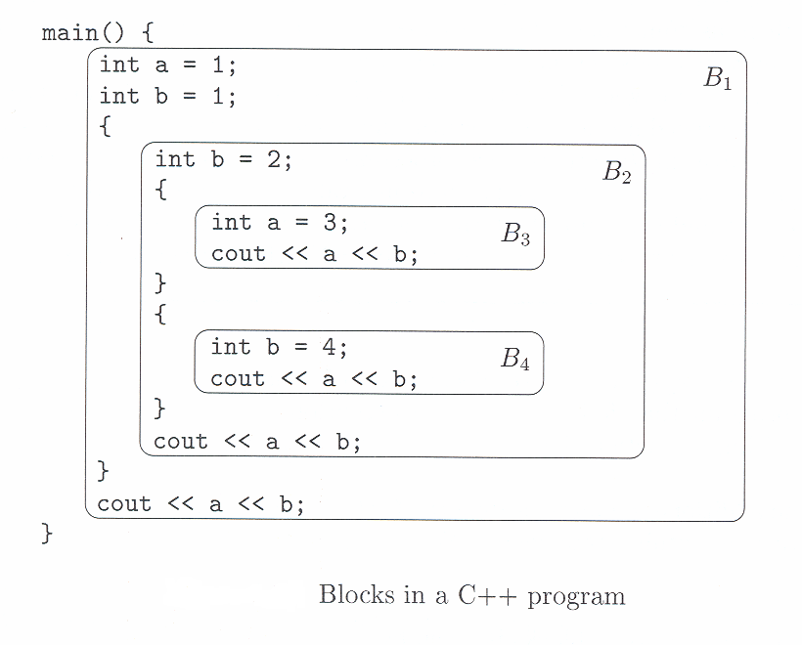

Slide 80
Sample input file for the Pascal program
PROGRAM hello (output);
{Write 'Hello, world.' ten times.}
VAR
i : integer;
BEGIN {hello}
FOR i := 1 TO 10 DO BEGIN
writeln('Hello, world.');
END;
END {hello}.

Slide 81
Sample output from the Pascal tokenizer
Line number
1 0: PROGRAM hello (output);
>> PROGRAM PROGRAM
>> <IDENTIFIER> hello
>> ( (
>> ) )
>> ; ;
2 0:
3 0: {Write 'Hello, world.' ten times.}
4 0:
5 0: VAR
>> VAR VAR
6 0: i : integer;
>> <IDENTIFIER> i
>> : :
>> <IDENTIFIER> integer
>> ; ;
7 0:
8 0: BEGIN {hello}
>> BEGIN BEGIN
9 0: FOR i := 1 TO 10 DO BEGIN
>> FOR
>> <IDENTIFIER> i
>> := :=
>> <NUMBER> 1 (integer)
>> TO TO
>> <NUMBER> 10 (integer)
>> DO DO
Scope
token
lexeme

Slide 82
Sample output from the Pascal tokenizer
>> BEGIN BEGIN
10 0: writeln('Hello, world.');
>> <IDENTIFIER> writeln
>> ( (
>> <STRING> 'Hello, world.'
>> ) )
>> ; ;
11 0: END;
>> END END
>> ; ;
12 0: END {hello}.
>> END END
>> . .

